Slide 1
The Pittsburgh/Greater Allegheny LGBT+ Chamber of Commerce
Membership Launch Meeting
April 17, 2018

Slide 2
Agenda
Welcome & Introductions
What is Three Rivers Business Alliance (3RBA)?
What is the NGLCC?
What is an LGBTBE certification, and how will it help you grow your business?
What are 3RBA's membership requirements?
What sponsorship opportunities exist?
Why should you join 3RBA?
Other questions?

Slide 3
Impact of LGBT+ Businesses in US
Available to https://www.youtube.com/watch?v=nXSObXorj5U

Slide 4
What is 3RBA?
3RBA is a chamber of commerce.
3RBA focuses on promoting, expanding and improving the economic interests and business opportunities of LGBT+ individuals and their allies.
3RBA's geographical focus is the Pittsburgh/ Greater Allegheny region:
Southwestern Pennsylvania;
Southeastern Ohio;
Northern West Virginia; and
Northwestern Maryland.
3RBA has applied for tax exempt status under IRS Section 501(c)(6).

Slide 5
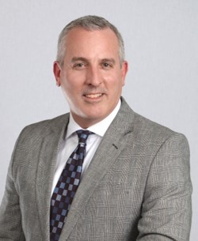
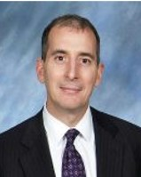
What is 3RBA?
3RBA is a member-based, PA nonprofit corporation governed by a board of directors and officers.
The current officers are:
Ronald L. Hicks, Jr., Pres. Stephen Donaldson, V.P. Conrad Bricker, Treas. Michael Testa, Sec.

Slide 6
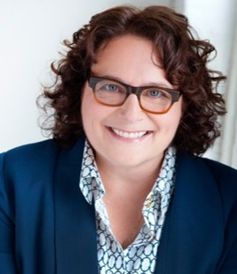
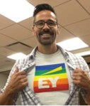
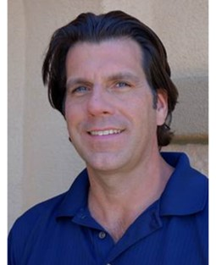
What is 3RBA?
With the officers, the current directors are:
Denise DeSimone Sean Gray John E. Kandray Mark Winner
Directors have been divided into 3 classes, with 5 elected each year.
3RBA’s committees include Membership, Programming and Finance.

Slide 7
What is 3RBA?
3RBA is one of three Pennsylvania affiliate chambers of the NGLCC:
Central Pennsylvania Gay & Lesbian Chamber of Commerce (Harrisburg)
Independence Business Alliance (Philadelphia)
Membership in 3RBA provides you access to NGLCC resources and corporate partners.
As a 3RBA member, NGLCC's LGBT Business Enterprise certification fee is waived.

Slide 8
What is NGLCC?
Available to https://www.youtube.com/watch?v=rsEW03BLSiA

Slide 9
LGBTBE Certification
Available at https://www.youtube.com/watch?v=NWWp3RDHbW0

Slide 10
LGBTBE Certification
Available at https://www.youtube.com/watch?v=Bw8v_lqVBDQ

Slide 11
3RBA Membership
Membership in 3RBA is open to any person (defined broadly to include any legal entity and individual at least 18 years of age) who:
Agrees to 3RBA’s Mission and its Professional Code of Conduct;
Pays all dues and fees; and
Complies with such other rules and requirements as the Board of Directors may from time to time adopt.
3RBA has 6 classes of membership.
Membership is available to any person who supports LGBT+ businesses.

Slide 12
3RBA Sponsorship
3RBA’s principal sources of revenue are membership dues, meeting fees, grants and sponsorships.
3RBA has 6 classes of sponsorships:
All include Business Premium/Corporate Membership ($500).
Memberships can be upgraded to any sponsorship by paying the difference.
3RBA also may have sponsorships for particular meetings, events and other activities.

Slide 13
Why Join 3RBA?
Networking opportunities
Access to NGLCC resources and events, including 2018 IBL Conference in Philadelphia
LGBTBE certification fee waiver
Different fees/discounts on meetings and member-only events
Leadership opportunities
Learn about and advocate on key issues affecting LGBT+ businesses

Slide 14
Questions

Slide 15
The Pittsburgh/Greater Allegheny LGBT+ Chamber of Commerce
535 Smithfield St., Suite 1300, Pgh., PA 15222
412-346-4161 / info@3RBA.com
www.3rba.com

